Slide 1
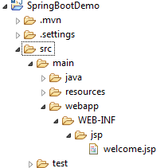
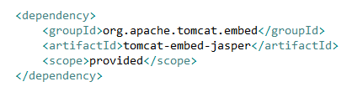
Spring Boot + Spring MVC + JSP Hello World Example
MVC application unlike previous examples, we have to create a webapp folder under /src/main (src > main > webapp) where we will place all our .jsp files.

Slide 2

Spring Boot + Spring MVC + JSP Hello World Example
In this example, I am going to put all my .jsp file(s) under /WEB-INF/jsp/ folder, no need to mention ‘webapp’ in the properties file as spring boot by default consider that folder and search under webapp.

